Slide 1
CS:4420 Artificial Intelligence
Spring 2018
Beyond Classical Search
Cesare Tinelli
The University of Iowa
Copyright 2004–18, Cesare Tinelli and Stuart Russell ª
a
These notes were originally de eloped by Stuart Russell and are used with permission. They are
copyrighted material and may not be used in other course settings outside of the Uni ersity of Iowa in their current or modified form without the express written consent of the copyright holders.

Slide 2
Readings
•
Chap. 4 of [Russell and Norvig, 2012]

Slide 3
Beyond Classical Search
We have seen methods that systematically explore the search space, possibly using principled pruning (e.g., A*)
The best of these methods can currently handle search spaces of up to
10¹⁰⁰ states / ~1,000 binary variables (ballpark figure)
What if we have much larger search spaces?
Search spaces for some real-world problems may be much larger e.g.,
10^{30,000} states as in certain reasoning and planning tasks
Some of these problems can be solved by Iterative Improvement Methods

Slide 4
Iterative Improvement Methods
In many optimization problems the goal state itself is the solution
The state space is a set of complete configurations
Search is about finding the optimal configuration (as in TSP) or just a feasible configuration (as in scheduling problems)
In such cases, one can use iterative improvement, or local search, methods
An evaluation, or objective, function h must be available that measures the quality of each state
Main Idea: Start with a random initial configuration and make small, local changes to it that improve its quality

Slide 5
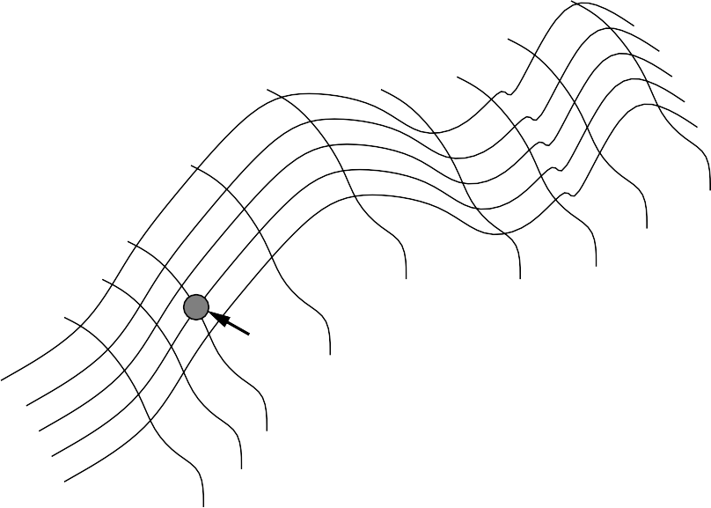
Local Search: The Landscape Metaphor
Ideally, the evaluation function h should be monotonic: the closer a state to an optimal goal state the better its h-value.
Each state can be seen as a point on a surface.
The search consists in moving on the surface, looking for its highest peaks (or, lowest valleys): the optimal solutions.
evaluation
current state

Slide 6










Local Search Example: TSP
TSP: Travelling Salesperson Problem
h = length of the tour
Strategy: Start with any complete tour, perform pairwise exchanges
CS:4420 Spring 2018 – p.6/27

Slide 7
Local Search Example: TSP
TSP: Travelling Salesperson Problem
h = length of the tour
Strategy: Start with any complete tour, perform pairwise exchanges
Variants of this approach get within 1% of optimal very quickly with thousands of cities
CS:4420 Spring 2018 – p.6/27

Slide 8












Local Search Example: n-queens
•
Put n queens on an n × n board with no two queens on the same row, column, or diagonal
h = number of conflicts
Strategy: Move a queen to reduce number of conflicts
•
•
h = 5
h = 2
h = 0
CS:4420 Spring 2018 – p.7/27

Slide 9
Local Search Example: n-queens
•
Put n queens on an n × n board with no two queens on the same row, column, or diagonal
h = number of conflicts
Strategy: Move a queen to reduce number of conflicts
•
•
h = 5 h = 2 h = 0
Almost always solves n-queens problems almost instantaneously for very large n, e.g., n = 10⁶
CS:4420 Spring 2018 – p.7/27

Slide 10
Hill-Climbing Search
Aka: gradient descent/ascent search
“Like climbing Everest in thick fog with amnesia”
function Hill-Climbing( problem) returns a state that is a local maximum
inputs: problem, a problem
local vars: current, a node
neighbor, a node
current → Make-Node(Initial-State[problem])
loop do
neighbor → a highest-valued successor of current
if Value[neighbor] < Value[current] then return State[current]
current → neighbor
end

Slide 11
Hill-Climbing: Shortcomings
•
•
•
Depending on the initial state, it can get stuck on local maxima It may converge very slowly
In continuous spaces, choosing the step-size is non-obvious
objective function
global maximum
shoulder
local maximum
"flat" local maximum
current state
state space
CS:4420 Spring 2018 – p.9/27

Slide 12
Hill-Climbing: Shortcomings
•
•
•
Depending on the initial state, it can get stuck on local maxima It may converge very slowly
In continuous spaces, choosing the step-size is non-obvious
objective function
global maximum
shoulder
local maximum
"flat" local maximum
current state
state space
However, true local optima are surprisingly rare in high-dimensional spaces. There often is an escape to a better state
CS:4420 Spring 2018 – p.9/27

Slide 13
Hill Climbing: Improvements
Various possible alternatives:
Restart from a random point in the space
Look ahead: expand up to m > 1 generations of descendants before choosing best node
Introduce noise: allow down-hill moves sometimes
Keep n > 1 nodes in the fringe at each step
CS:4420 Spring 2018 – p.10/27

Slide 14
Simulated Annealing Search
Idea: improve hill-climbing by allowing occasional down-hill steps, to minimize the probability of getting stuck in a local maximum
Down-hill steps taken randomly but with probability that decreases with time
Probability controlled by a given annealing schedule for a temperature
parameter T
If schedule lowers T slowly enough, search is guaranteed to end in a global maximum
Catch: it may take several tries with test problems to devise a good annealing schedule

Slide 15
Simulated Annealing Algorithm
function Simulated-Annealing( problem, schedule) returns a solution state
inputs: problem, a problem
schedule, a mapping from time to “temperature”
local vars: current, a node
next, a node
T, a “temperature” controlling prob. of downward steps
current → Make-Node(Initial-State[problem])
for t → 1 to ∞ do
T → schedule[t]
if T = 0 or Is-Goal-State(current) then return current next → a randomly selected successor of current
∆E → Value[next] – Value[current]
if ∆E > 0 then current → next
E|
else current → next only with probability
1
e
|∆
T

Slide 16
Properties of Simulated Annealing
Note:
1
e
|∆ E|
is directly proportional to T and inversely proportional to |∆E|
T
It can be proven that if T is decreased slowly enough, the search converges to the best state
This is not necessarily an interesting guarantee
Devised by Metropolis et al., 1953, for physical process modeling Widely used in VLSI layout, airline scheduling, etc.

Slide 17
Local Beam Search
Idea: improve hill-climbing by keeping k states instead of 1; choose top k of all their successors
Not the same as k searches run in parallel!
Searches that find good states recruit other searches to join them
Problem: quite often, all k states end up on same local maximum Solution: choose k successors randomly, biased towards good ones

Slide 18
Genetic Algorithms
Inspired by Darwin’s theory of natural selection
Each state is seen as an individual in a population
A genetic algorithm applies selection and reproduction operators to an initial population
The aim is to generate individuals that are most successful, according to a given fitness function
It is basically a stochastic local beam search, but with successors generated from pairs of states
Local maxima are avoided by giving a nonzero chance of reproduction to low-scoring individuals

Slide 19
The Basic Genetic Algorithm
function GENETIC-ALGORITHM( population, FITNESS-FN) returns an individual inputs: population, a set of individuals
FITNESS-FN, a function that measures the fitness of an individual
repeat
parents Selection( population, Fitness-Fn) population Reproduction( parents)
until some individual is fit enough
return the best individual in population, according to FITNESS-FN
•
Variation operators used in Reproduction create the necessary diversity, facilitating novelty
Selection reduces diversity but pushes quality by increasing fitness
•

Slide 20
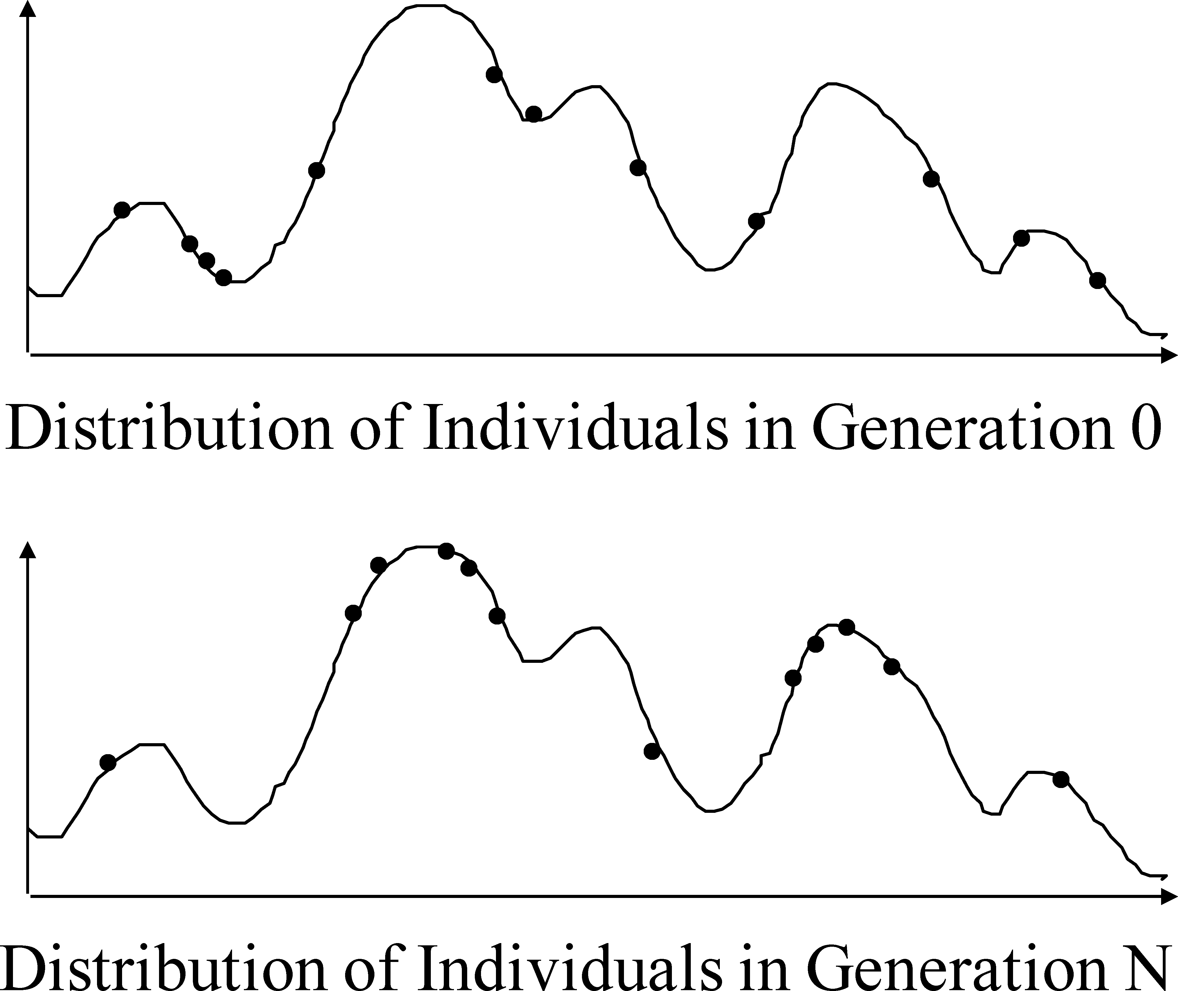
Improving fitness
Abstract example: changes of values of fitness function

Slide 21


Genetic Algorithms: Classic Approach
•
•
•
Each state is represented by a finite string over a finite alphabet. Each character in the string is a gene.
The selection mechanism is randomized, with the probability of selection proportional to the fitness measure.
Reproduction is accomplished by crossover and mutation.
•
24748552
24 31%
3275
2411
3274
8552
32748152
32752411
23 29%
2474
8552
2475
2411
24752411
24415124
20 26%
327524
11
327521
24
32252124
32543213
11 14%
(b) Fitness Function
244151
24
244154
11
24415417
(a)
Initial Population
(c) Selection
(d) Cross−Over
(e) Mutation

Slide 22
Possible Encodings
Character strings
Sequences of real numbers Tuples of elements
Lists of rules Program elements
. . .
0101 · · · 1100
(43.2 -33.1 · · · 0.0 89.2)
(E11 E3 E7 · · · E1 E15) (R1 R2 R3 · · · R22 R23)
(genetic programming)

Slide 23
























Encodings for Genetic Algorithms
Choosing the right encoding of state configurations to strings is crucial.
Crossover helps only if substrings are meaningful components that can be reassembled into a new meaningful configuration.
+
=
Note: GAs are not evolution: e.g., real genes encode replication machinery!
CS:4420 Spring 2018 – p.20/27

Slide 24
Problem Encoding
Problem: Find location that is closest to several given cities
Population encoding: Express location l as a 16-bit string
l = 1001010101011100
with the first 8 bits representing the location’s X-coordinate and the second 8 bits representing the Y-coordinate
Fitness function: Median distance of location from each city
Combination: Crossover of X-coordinate from one parent and Y-coordinate from the other
Mutation: one or more bit flips

Slide 25
Problem Encoding
Problem: Finding the max value of some function f : [0, 1)^{n} → R
Population encoding: Vectors of size n with elements from [0, 1)
Combination: Various options
Mutation: randomly replace a value in the vector with one from [0, 1)

Slide 26
Discrete Recombination
Similar to crossover
Equal probability of receiving each parameter from either parent Example:
(8, 12, 31, ... , 5)
(2, 5, 23, ... , 14)
⇓
(2, 12, 31, ... , 14)

Slide 27
Intermediate Recombination
Each child component is the average of the corresponding parent components
Example:
(8, 12, 31, ... , 5)
(2, 5, 23, ... , 14)
⇓
(5, 8.5, 27, ... , 9.5)

Slide 28
GA for the Traveling Salesperson Probl.
Problem: Find a tour of a given set of cities so that each city is visited only once and
total traveled is minimal
Representation: An ordered list of city numbers
(known as order-based GA)
1) London | 3) Iowa City | 5) Beijing | 7) Tokyo
2) Venice Ex., | 4) Singapore | 6) Phoenix | 8) Victoria
CityList1 CityList2
(3 5 7 2 1 6 4 8)
(2 5 7 6 8 1 3 4)

Slide 29
GA for the Traveling Salesperson Probl.
Combination: Order 1 crossover (combines inversion and recombination):
Copy a randomly selected portion of Parent 1 to Child
Fill the blanks in Child with those numbers in Parent 2 from left to right, avoiding duplicates in Child
Parent 1 | (3 5 7 2 1 6 4 8)
Parent 2 | (2 5 7 6 8 1 3 4)
Child | (5 8 7 2 1 6 3 4)

Slide 30
GA for the Traveling Salesperson Probl.
Mutation: swap two numbers in the list
Before: (5 8 7 2 1 6 3 4)
After: (5 8 6 2 1 7 3 4)

